Slide 1


Trio-topic presents: Taskmanage
Dylan winter, Eva Santana, Alex solomon
Notes:
Initially aim for 12-15 slides to fill 15 minutes of time

Slide 2
Introduction of Team members
Eva:
Created initial idea of the TaskManage project
Created the GitHub repository
Worked on supplementary material (like documentation document)
more

Slide 3
Introduction of Team members
Dylan:
Visionary and Implementer:
Conceived most elements of TaskManage and was the one who implemented these abstract concepts and goals into a tangible form.
Designed and wrote the vast majority of the code.
Initial and Continued GUI Design:
Creator of the initial GUI diagrams, pioneering the first potential look of the program.
Responsible for integrating my team’s contributions into the project, and for then improving upon them.
Project Structure:
Designed the project structure--such as how the files are organized--and developed the packages, facade and interface classes, and Java class files (in addition to extra things such as resource root directory).
Group Leadership:
Emerged as the leader of TrioTopic group over time and directed the course of the project.
Consistently updated the group on progress and tried to properly direct us towards productive endeavors.
Database and Security Integration:
Responsible for integrating the use of a local database in our program, alongside with implementing security practices.

Slide 4
Introduction of Team members
Alex:

Slide 5

Introduction to the TaskManage application

Slide 6

More than just a to-do list
Empowerment for Users: The primary goal of TaskManage is to empower users to achieve both short-term and long-term goals. It is designed to help users become more productive and understand their patterns of success and failure.
Data-Driven Insights: A standout feature is the app's ability to leverage accumulated user data to provide valuable insights. This allows users to identify variables correlated with higher success and factors associated with lower chances of success

Slide 7
Long term & short term based
Long Term Improvement
Short Term Improvement
Pattern Identification: By leveraging accumulated user data, the app helps users identify variables that correlate with higher success in achieving their goals and factors associated with lower chances of success, promoting long-term personal growth.
Behavioral Analysis: Features like statistical graphs and task categorization allow users to analyze their habits and effectiveness over time, leading to profound personal revelations and strategies for sustained improvement.
Efficient Organization: The app supports daily tasks such as grocery shopping, running errands, and other fundamental activities, ensuring users can manage their day-to-day responsibilities effectively.
Reminder System: An integrated reminder system prompts users to complete tasks, helping them stay on track with immediate deadlines and improving their short-term productivity.

Slide 8
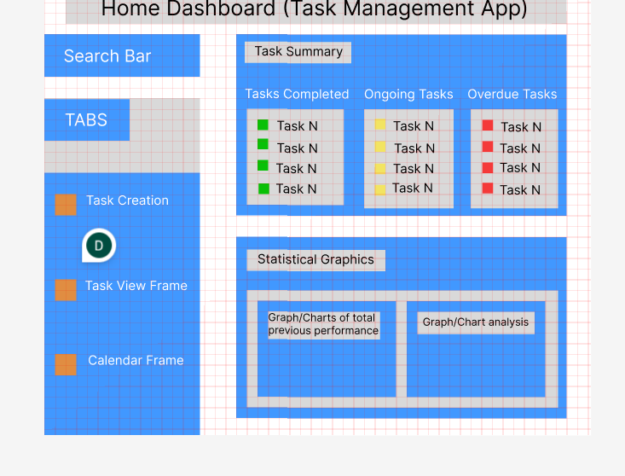
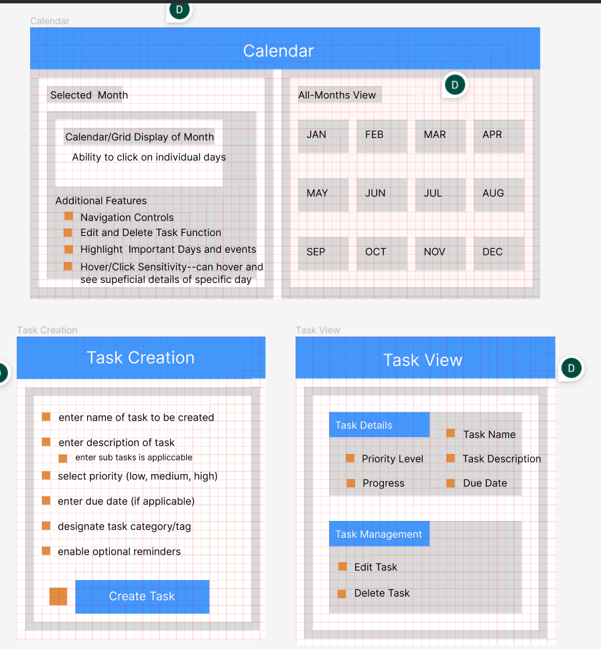
The four major app “screens”

Slide 9
The home dashboard
Designed to be the hub of the application
Two main sections: Task summary and Statistical graphics

Slide 10
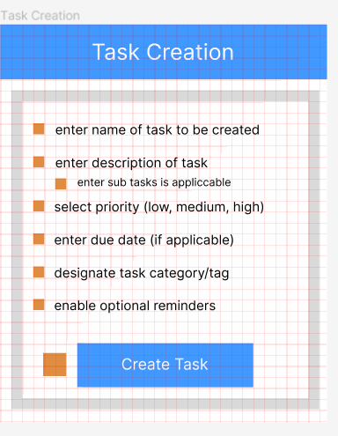
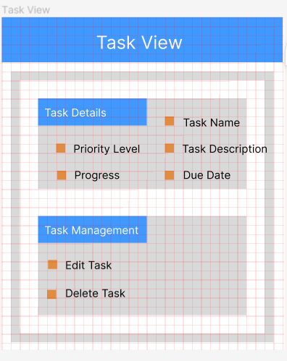
Task Creation & task view
Task Creation
Task View
Designed to include all the details included in creation
Many optional fields
Realistic and relevant criteria

Slide 11
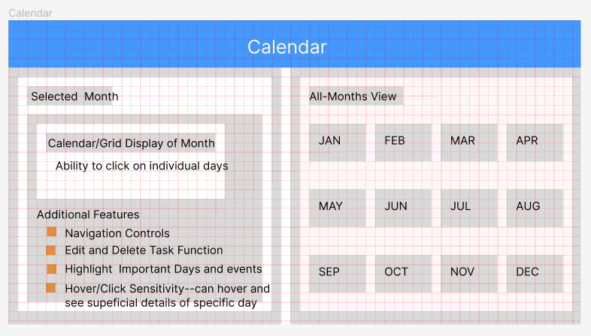
Calendar
2 Screens Within A Screen
Selected Month View
All Months View
Additional Features
Short Explanation

Slide 12

Demo Display & Explanation of design
Demo the full capabilities of each chosen screen
GUI Design
Database Design
Main Function Design
Collaboration of Components

Slide 13

Analysis of strengths:

Slide 14
A clear avenue of potential improvement
Solid foundations laid
TaskManage does not suffer from a lack of vision

Slide 15

Analysis of weaknesses

Slide 16
Weaknesses cut down to core of project
Controller logic & GUI FXML files still quite far from fully implemented
Code suffers from a lack of readability

Slide 17
Biting off more than one can chew & inexperience with setting realistic goals
Improper delegation and lack of balanced distribution of labor

Slide 18
Quick recap of Strengths & Weaknesses
Strengths
Lots of potential, clear path to improvement
solid foundation
Valuable lessons learned
Weaknesses
Code based
Team based

Slide 19
Thus concludes TrioTopic’s Presentation
Dylan winter, Eva Santana, Alex Solomon
The audience is granted permission to applause

Slide 20

QUESTIONS
possible questions: ?

